Slide 1
Follett Destiny for
Smartphones
How to use the Follett Destiny system to inventory
LAUSD musical instruments with Smartphones
By Joseph Yune

Slide 2
Things You’ll Need:
Smartphone
Student Roster (by Classrooms) with Library barcodes next to their names (Get it from the librarian or library aides)
LAUSD Instruments with Destiny barcode stickers

Slide 3
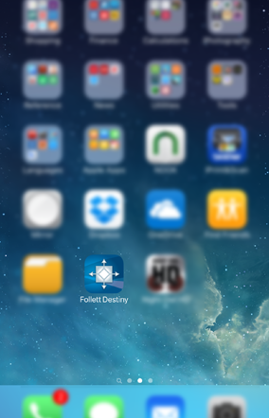
Downloading the App
Download the Follett Destiny app from your App Store. (It is free)

Slide 4
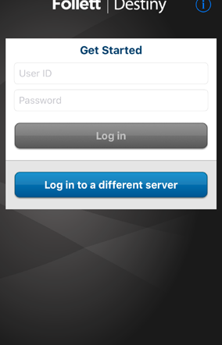
Opening the App
Once you open the app, you get the following screen.

Slide 5
Log-In Step 1
On the following screen, press “Log in to a different server” button.

Slide 6
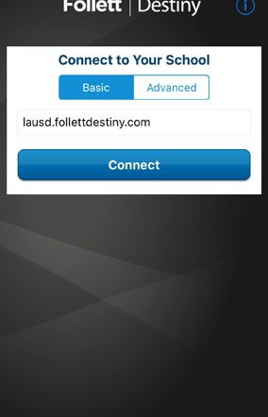
Log-In Step 2
On the following screen, type into the box: “lausd.follettdestiny.com”
Make sure the spelling is correct!
Then, press “Connect”

Slide 7
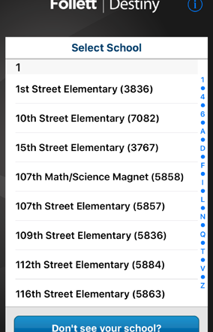
Log-In Step 3
Select your school from the following screen.
If you don’t see your school, contact:
  Oscar Gonzalez (ogonza3@lausd.net) 213-241-0465

Slide 8
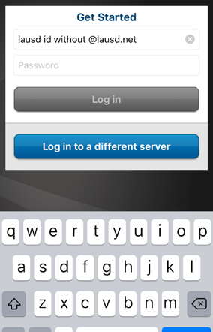
Log-In Step 4
Input your LAUSD ID (without @lausd.net) in the top box.
Input your LAUSD password in the bottom box.
Press “Log in”
If you cannot log in, your name is probably not in the Destiny system yet.

Slide 9
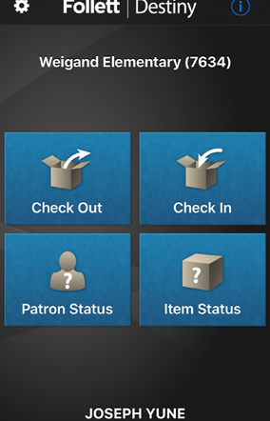
Checking Out Instruments
Step 1
Press “Check Out” button to check out instruments.

Slide 10
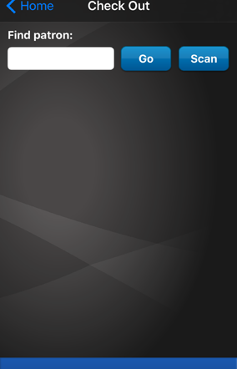
Checking Out Instruments
Step 2
On the following screen, press Scan button
Your phone will need to have the camera enabled for this app in order for this to work.

Slide 11
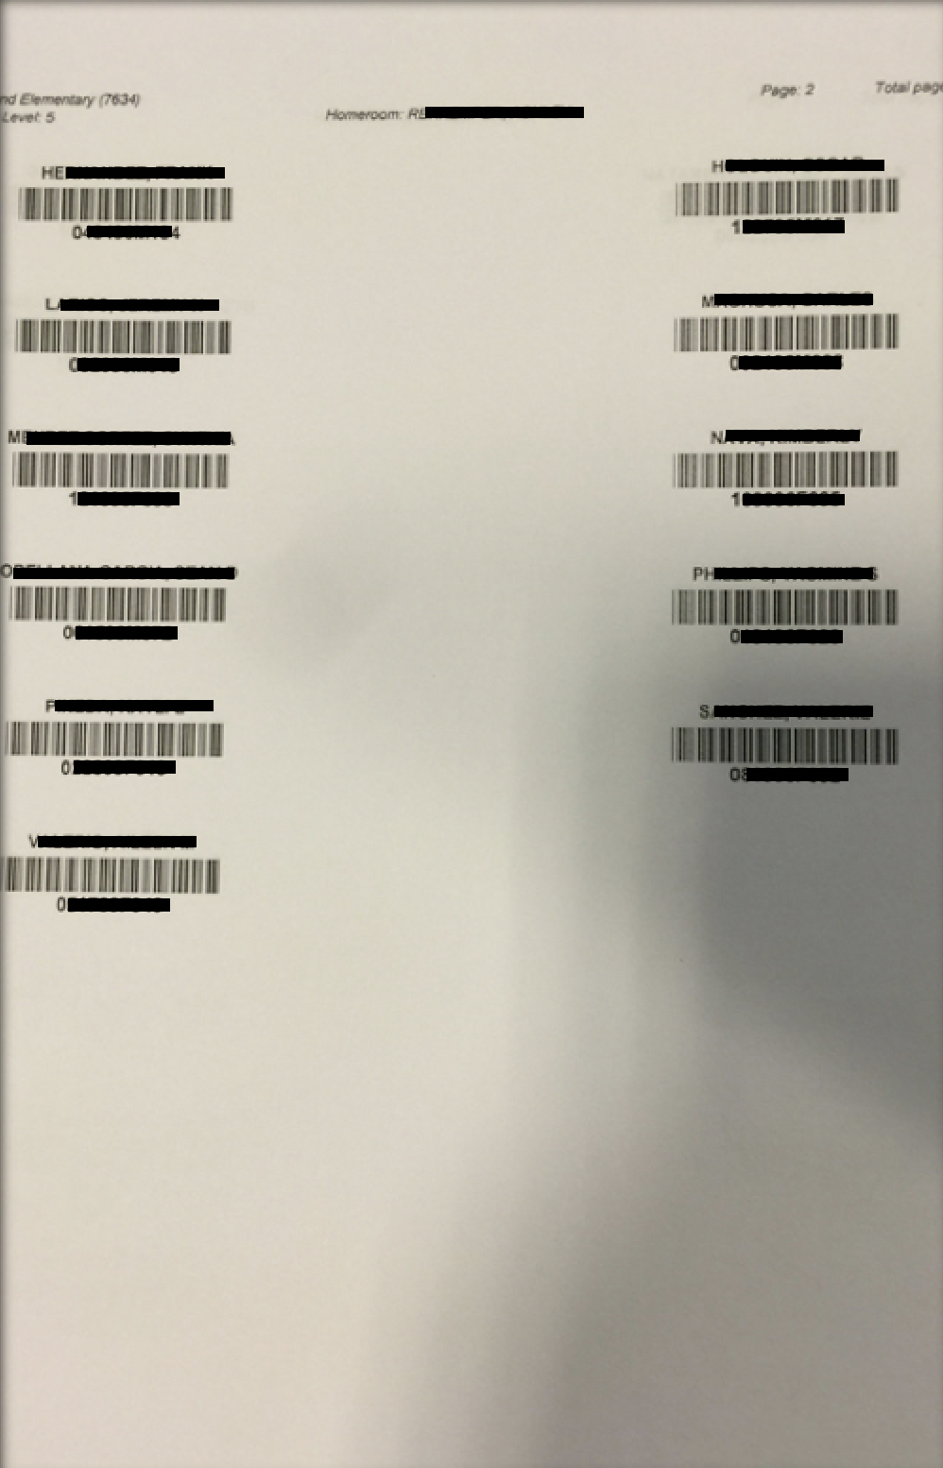
Checking Out Instruments
Step 3
Find the student name and scan the barcode.
If you make a mistake, press the “X” and try again.

Slide 12
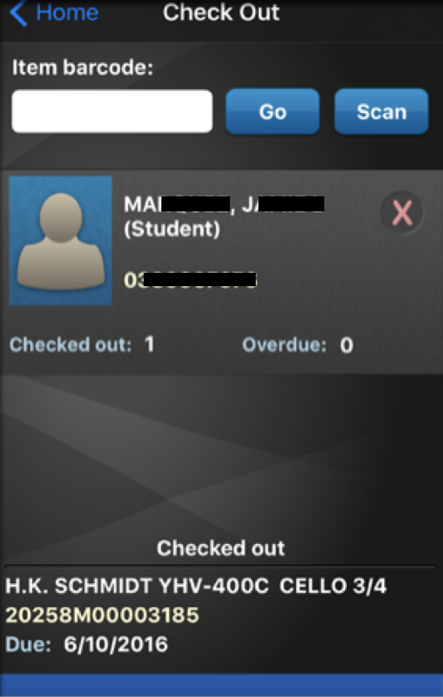
Checking Out Instruments
Step 4
Make sure it is the correct student and then press “Scan” to input the instrument.

Slide 13
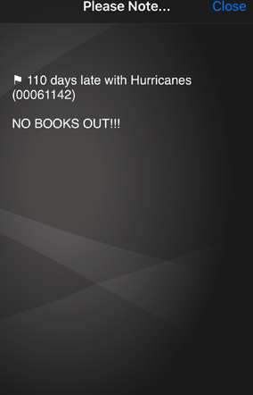
Error Message?
Sometimes, error messages appear as shown.
I chose not to check out instruments to students until the student resolved the problem with the librarian.
Press “Close” button (top right) to continue.

Slide 14
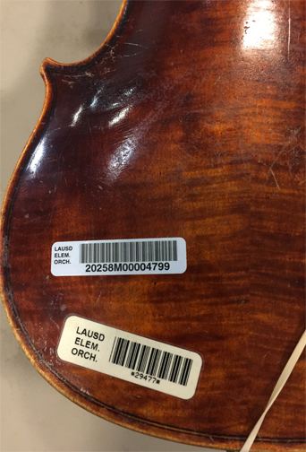
Checking Out Instruments
Step 5
Scan the new Destiny barcode (it looks similar to the one on top). New instruments will only have the new barcodes.
If it doesn’t have the Destiny barcode, you cannot use this system yet. You must use the old system.
I also document instrument information and serial numbers along with the barcodes (on a separate spread sheet)

Slide 15
Repeat the Process as needed
To change schools, you need to log out and repeat from: Log In Step 1 (Slide 5)

Slide 16
Questions?
Arts Education Branch:
  Joseph Yune (jty9169@lausd.net) 213-241-3368
ILTSS:
  Oscar Gonzalez (ogonza3@lausd.net) 213-241-0465

